Slide 1


PREDICTING DIABETES PATIENTS
BASED ON MACHINE LEARNING TECHNIQUES
Presented by
Raghad Alanazi, Sara Alsibgh, Atheer Almutairi, Danah Alanazi, Sarah Alhussein
Supervised By
Dr Hoda Ahmed Abdelhafez
2024-2025

Slide 2

Outlines
Introduction
Problem Statement
Proposed Solution & Objectives
Methodology
Requirement Specification
Workflow for developing a ML model
System Design
Implementation
Testing
Conclusion

Slide 3
Introduction
Diabetes is a chronic disease that poses a significant health challenge worldwide. Early prediction plays a key role in reducing its complications and improving patient outcomes.
In this project, we developed a predictive system using machine learning algorithms to analyze medical data and identify individuals at risk of diabetes.
By applying various classification models such as Decision Tree, Random Forest, Logistic Regression, Naïve Bayes, and Neural Networks on real patient data, we aimed to support healthcare providers in making early and accurate diagnoses.

Slide 4
Problem Statement
Diabetes is one of the most widespread chronic diseases in Saudi Arabia, with recent statistics showing that around 18.7% of adults aged 20–79 are affected.
The disease contributes significantly to complications such as kidney failure and cardiovascular issues. Early diagnosis is crucial to reducing these health risks, but traditional diagnostic methods are time-consuming and require constant monitoring. Therefore, there is a strong need for a fast, reliable, and intelligent solution to support early detection and improve treatment planning.

Slide 5
Proposed Solution & objectives
We propose a machine learning-based model to predict diabetes using patient medical data.
The model was developed using five algorithms
The dataset contains 1,000 records collected from Iraqi hospitals.
To improve prediction performance, we used the Wrapper Method for feature selection, identifying four key attributes: Gender, HbA1c, Triglycerides, and BMI.
The final model enables healthcare providers to detect diabetes early and make faster, more informed decisions

Slide 6
Methodology
1.Data Collection: 1,000 patient records from Iraqi hospitals (Medical City and Al-Kindy Teaching Hospital) are used.
2.Data Preprocessing: Handle missing values, duplicate values, and transformation using WEKA.
3.Feature Selection: Wrapper Method used to select the most relevant features for diabetes prediction.
4. Model Training: Machine learning algorithms: Naïve Bayes, Random Forest, Decision Trees, Logistic Regression and Neural Network are used.
5.Model Evaluation: Models evaluated using confusion matrix and performance metrics to ensure accuracy and reliability.

Slide 7
Requirement Specification
Input Data Collection
The dataset was collected from the Iraqi society,
from the Medical City Hospital and Al-Kindy Teaching Hospital's Specialized Center for Endocrinology and Diabetes.
It includes medical and laboratory data for 1000 patients: 844 Diabetic, 53 Pre-Diabetic, and 103 Non-Diabetic.
Attributes: Age, Gender, BMI, Creatinine Ratio (Cr), Urea, Cholesterol, LDL, VLDL, Triglycerides (TG), HDL, and HBA1C.
Patients classified into three categories: Diabetic, Pre-Diabetic, or Non-Diabetic.

Slide 8
Requirement Specification
Machine Learning Algorithms
Naïve Bayes (NB)
Neural Networks (NN)
Logistic Regression( LR)
Decision Tree (DT)
Random Forest (RF)

Slide 9
Requirement Specification
Feature Selection
Feature selection reduces dimensionality by keeping relevant features and removing redundant or noisy ones, simplifying models and enhancing performance.
We’ll use wrapper methods that evaluate feature subsets based on model accuracy, considering interactions to find the best combinations.

Slide 10
Requirement Specification
Evaluation
Recall (sensitivity )
Precision
Accuracy
Specificity (true negative rate)
F1-Score
Kappa Statistic
Relative Absolute Error (RAE)
Mean Absolute Error (MAE)
Root Mean Squared Error (RMSE)
Root Relative Squared Error (RRSE)
Matthews Correlation Coefficient (MCC)
ROC (Receiver Operating Characteristic) Area (AUC-ROC)
PRC (Precision-Recall Curve) Area

Slide 11
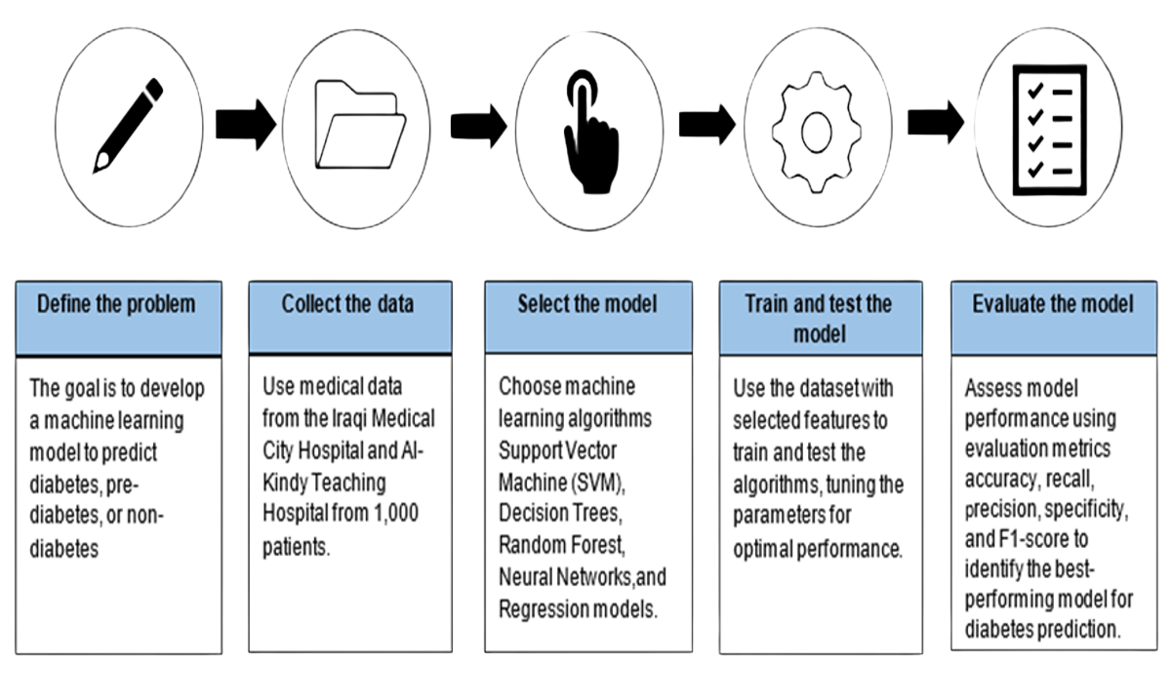
Workflow for developing a ML model

Slide 12
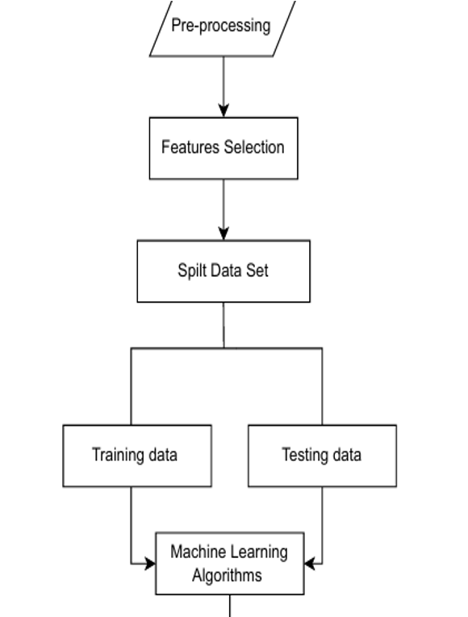
System Design

Slide 13

Implementation

Slide 14
Implementation Requirements
Hardware
Processor : i5 core / Ryzen 5
RAM : 8 GB
Storage: 100 GB
Graphics Card: Integrated GPU
OS: Windows 10/11
Software
Tool : WEKA for data processing and model training & testing
• Input CSV file
• Feature Selection
• Model Training and testing
• Evaluation Metrics

Slide 15
Implementation Details
Data Preparation
A dataset containing medical features was imported into WEKA and split into 70% for training and 30% for testing.
Feature Selection
Using the Wrapper Method, the top 4 features were selected:
Gender, HbA1c, Triglycerides, BMI
Evaluation Metrics
Accuracy, Precision, Recall, F1-Score, MAE, RMSE, Kappa, ROC, PRC

Slide 16
Applying the Five Algorithms
Naïve Bayes
features | Accuracy | Precision | Recall | F-Measure | MCC | ROC Area | PRC Area
All faetures | 94% | 0.950 | 0.940 | 0.943 | 0.813 | 0.947 | 0.956
Wrapper method | 96.67% | 0.970 | 0.967 | 0.967 | 0.894 | 0.986 | 0.983

Slide 17
Applying the Five Algorithms
Logistic Regression
features | Accuracy | Precision | Recall | F-Measure | MCC | ROC Area | PRC Area
All faetures | 91.3% | 0.709 | 0.907 | 0.913 | 0.904 | 0.230 | 0.913
Wrapper method | 92% | 0.509 | 0.617 | 0.897 | 0.684 | 0.377 | 0.897

Slide 18
Applying the Five Algorithms
Neural Networks
features | Accuracy | Precision | Recall | F-Measure | MCC | ROC Area | PRC Area
All faetures | 96% | 0.967 | 0.963 | 0.964 | 0.846 | 0.992 | 0.990
Wrapper method | 97.67% | 0.979 | 0.977 | 0.977 | 0.920 | 0.994 | 0.990

Slide 19
Applying the Five Algorithms
Random Forest
features | Accuracy | Precision | Recall | F-Measure | MCC | ROC Area | PRC Area
All faetures | 98% | 0.980 | 0.980 | 0.980 | 0.929 | 0.987 | 0.991
Wrapper method | 97.67% | 0.977 | 0.977 | 0.976 | 0.916 | 0.999 | 0.999

Slide 20
Applying the Five Algorithms
Decision Tree
features | Accuracy | Precision | Recall | F-Measure | MCC | ROC Area | PRC Area
All faetures | 99% | 0.987 | 0.987 | 0.987 | 0.954 | 0.978 | 0.983
Wrapper method | 98.33% | 0.984 | 0.983 | 0.983 | 0.940 | 0.963 | 0.977

Slide 21
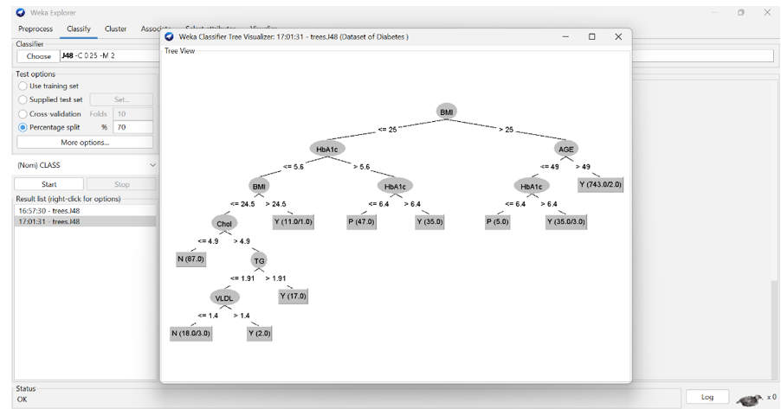
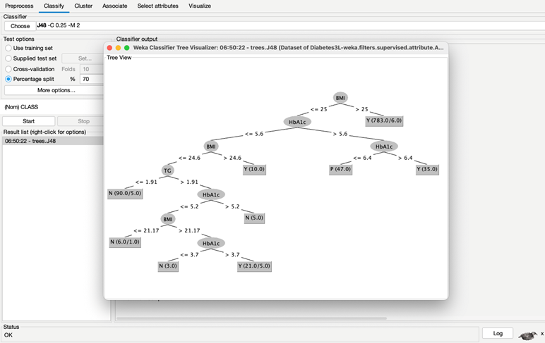
Applying the Five Algorithms
Decision Tree
Decision Tree visualization for all features
Decision Tree visualization for four features

Slide 22
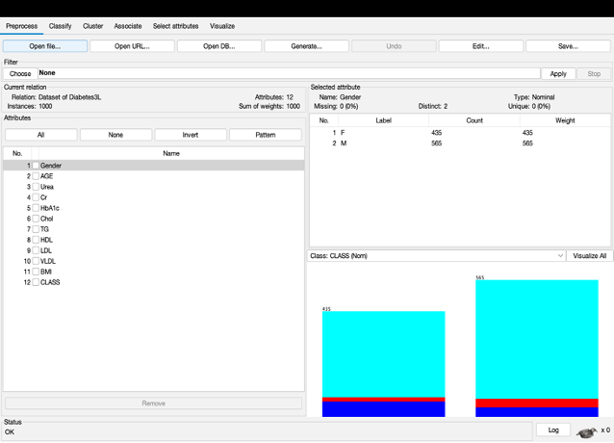
I/O Screens
Dataset uploaded in WEKA

Slide 23
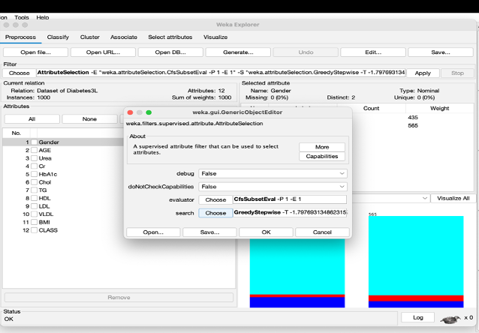
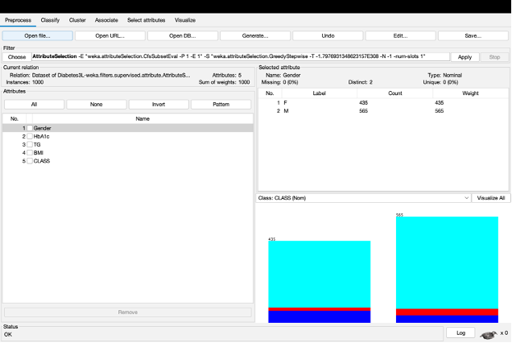
I/O Screens
feature selection using wrapper method

Slide 24
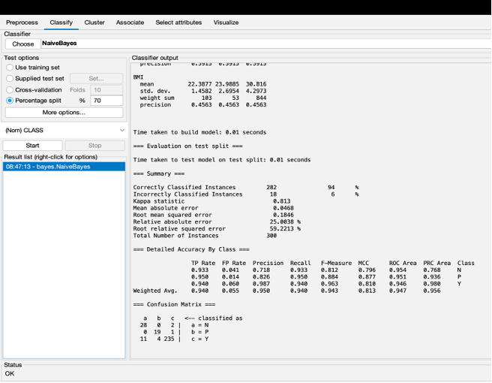
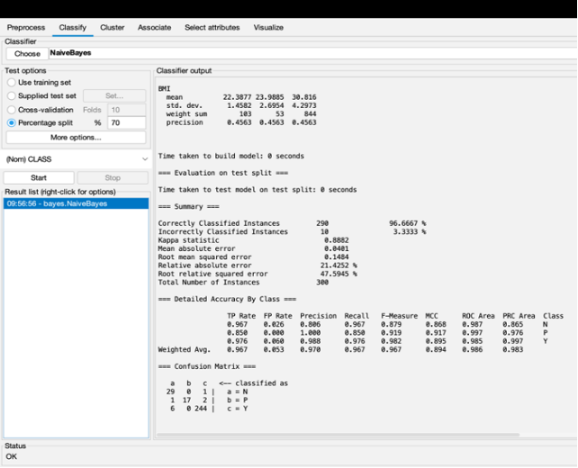
I/O Screens
Naïve Bayes algorithm with feature selection
using Wrapper method.
Naïve Bayes algorithm with all features.

Slide 25
Testing

Slide 26
Test plan
The dataset was divided into 70% for training and 30% for testing using WEKA.
Each model was trained and tested with and without feature selection to compare performance.
We used several metrics to measure the results, including Accuracy, Precision, Recall, F1-Score, ROC Area, and MCC.

Slide 27
Testing Process
Data preprocessing validation: Ensuring missing values and inconsistencies in the dataset caused by duplicate records are correctly handled before training.
Machine learning model performance
Feature selection impact: Analyzing the effect of using the Wrapper Method on model accuracy.
System reliability: Evaluating model effectiveness using performance metrics such as accuracy, precision, recall, and F1-score.

Slide 28
Test cases
Test Case | Expected Outcome
1- Validation Check | All data has been validated, and no invalid entries were found.
2- Handling Missing Values | No missing values were detected in the dataset.
3- Check Duplicate Data | Duplicate patient records were identified and removed.
4- Feature Selection | The Wrapper Method was correctly applied to select the most relevant features.
5- Model performance with selected features | The model was trained using the selected features, and its performance was evaluated to verify that the feature selection enhanced accuracy or not
6-Testing the model with all features | The model was tested using all available features. Performance metrics were recorded to compare the results with the model that used only selected features.
7- Testing the model performance model with different algorithms | Various machine learning algorithms were applied to the dataset, and their performance was compared to identify the most suitable one.

Slide 29
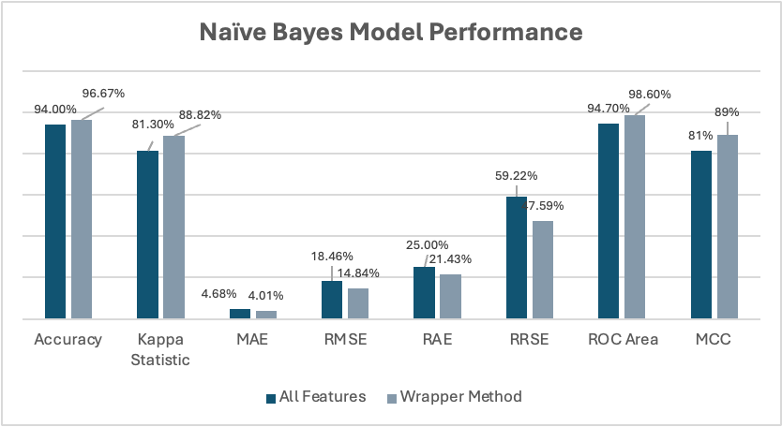
Test results

Slide 30
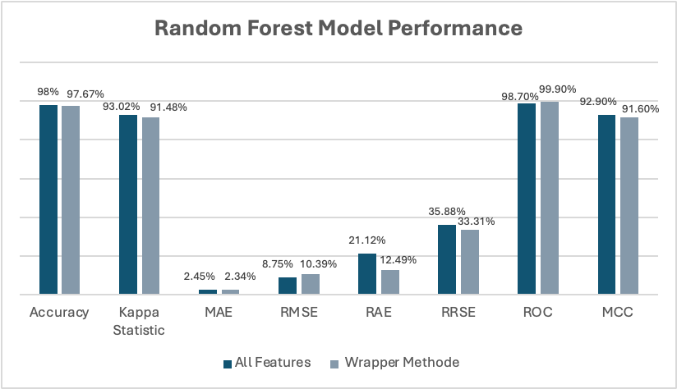
Test results

Slide 31
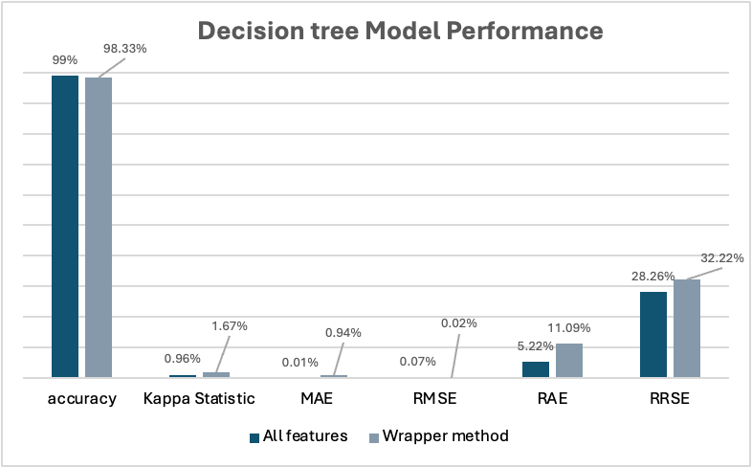
Test results

Slide 32
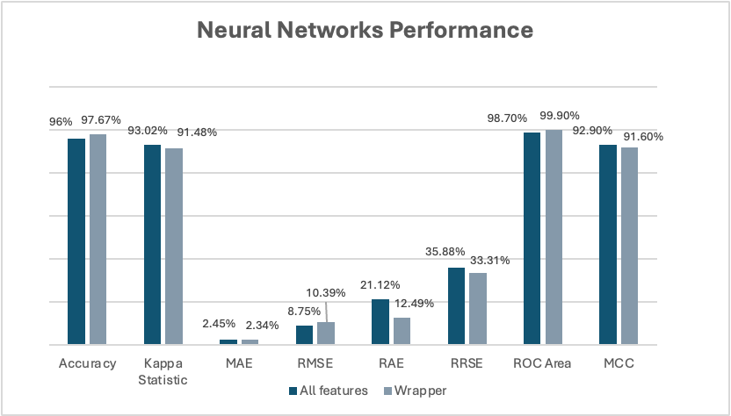
Test results

Slide 33
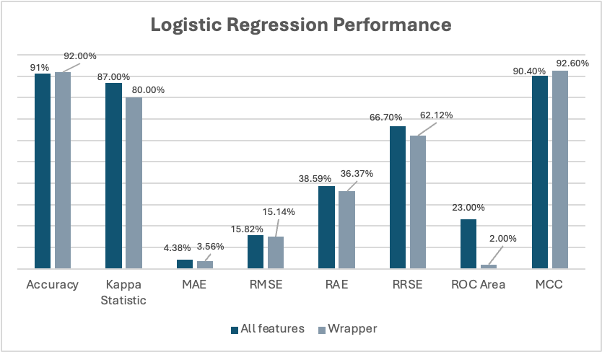
Test results

Slide 34
Performance by machine learning algorithms
ML Algorithm | Accuracy (All) | Accuracy (Wrapper) | F-Measure (All) | F-Measure (Wrapper) | ROC (All) | ROC (Wrapper) | MCC (All) | MCC (Wrapper)
NB | 94% | 96.67% | 0.943 | 0.967 | 0.947 | 0.986 | 0.813 | 0.894
LR | 91.3% | 92% | 0.883 | 0.897 | 0.247 | 0.377 | 0.908 | 0.684
NN | 96% | 97.67% | 0.964 | 0.977 | 0.992 | 0.994 | 0.846 | 0.920
RF | 98% | 97.67% | 0.980 | 0.976 | 0.987 | 0.999 | 0.928 | 0.916
DT | 99% | 98.33% | 0.987 | 0.983 | 0.978 | 0.963 | 0.954 | 0.940

Slide 35
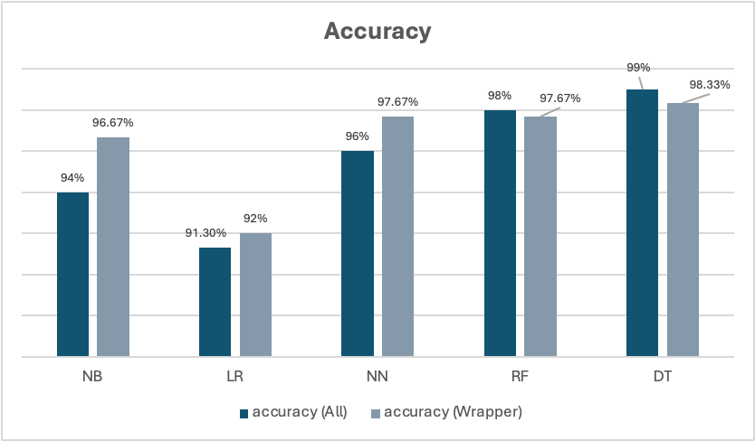
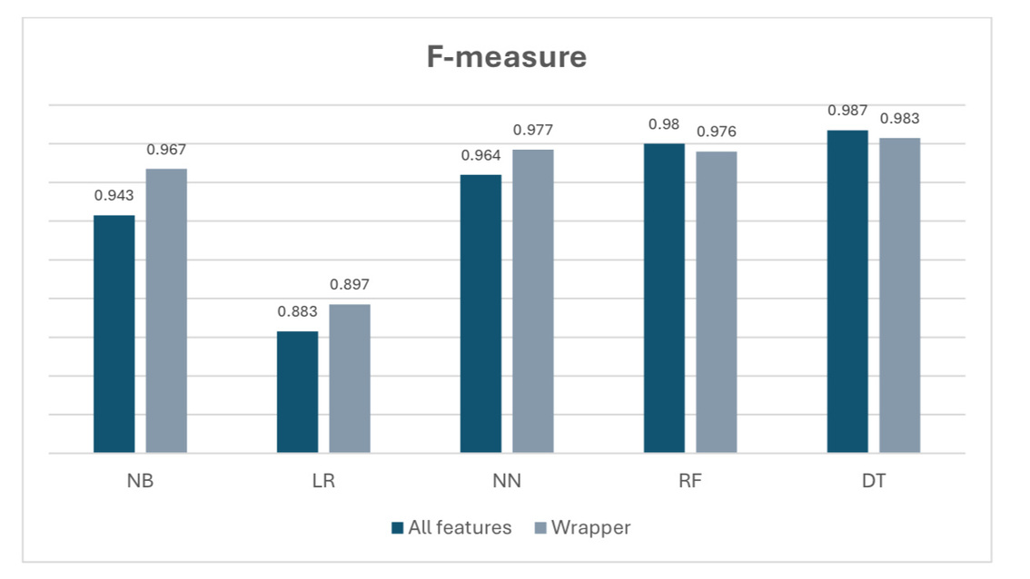
Performance of five machine learning algorithms using all features and the Wrapper method

Slide 36
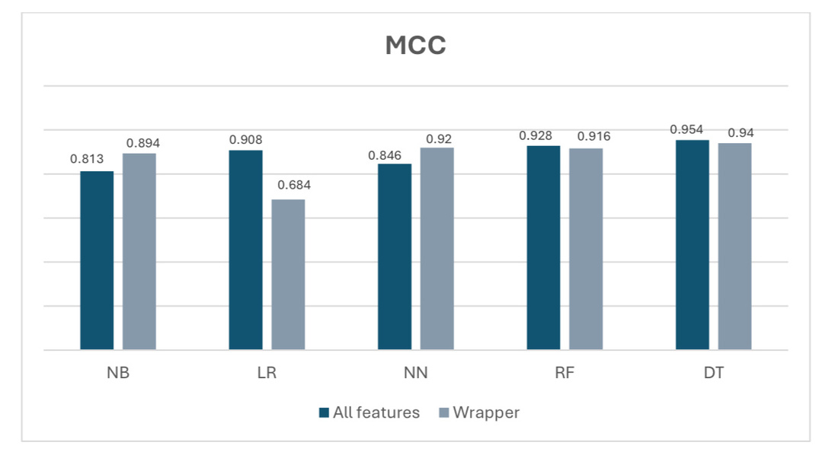
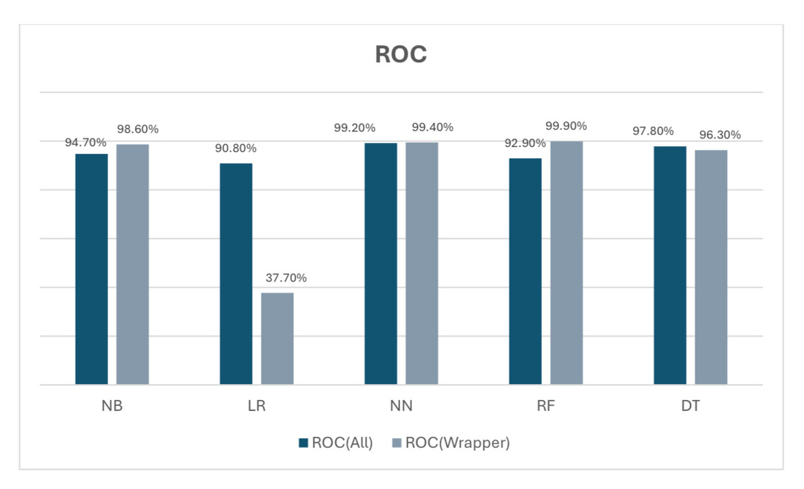
Performance of five machine learning algorithms using all features and the Wrapper method

Slide 37
Conclusion

Slide 38
Evaluation
The graduation project achieved its goal of developing a diabetes prediction model using machine learning.
The model supports early diabetes detection and offers a solid base
for future work in predictive healthcare.
Data from 1,000 real patients in Iraq was collected, including key medical attributes.
Five algorithms were tested in WEKA, with Decision Tree and Random Forest performing best.
Using wrapper-based feature selection improved accuracy.
The Decision Tree achieved the best result with 99% accuracy.

Slide 39

Future work
Larger Dataset: Expanding the dataset to include more diverse patients would improve accuracy.
Additional Risk Factors: Including lifestyle factors like diet, exercise, and family history would enhance predictions.
Continuous Learning: Implementing a system that learns from new data will keep the model up-to-date and improve over time.

Slide 40
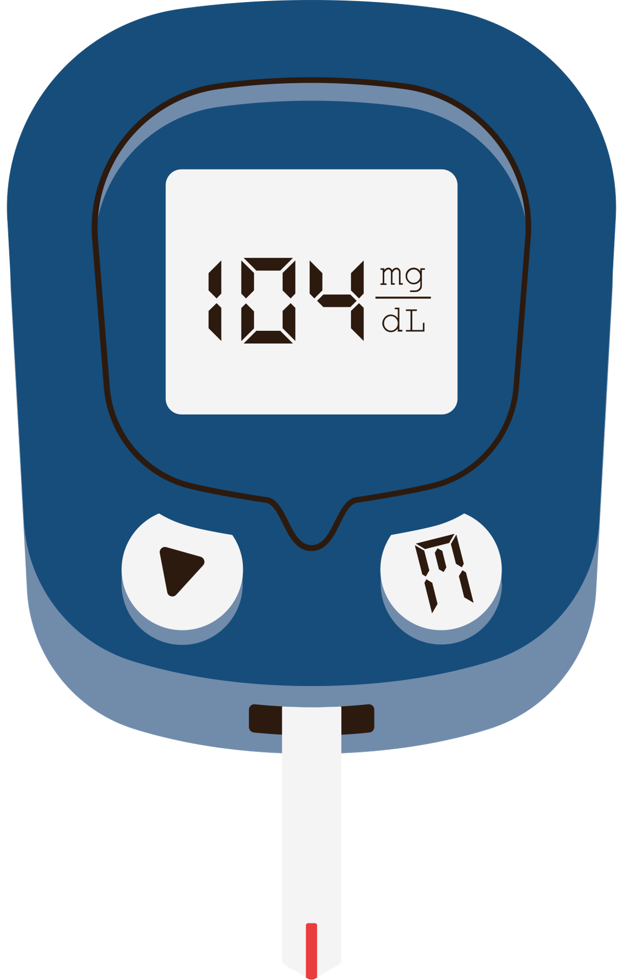
Thank you

